Slide 1

BMS INSTITUTE OF TECHNOLOGY AND MANAGEMENT Yelahanka, Bengaluru – 560064 DEPARTMENT OF TELECOMMUNICATION ENGINEERING
Introduction To Artificial Intelligence
Flip Activity
on
Path Finding using BFS
Presented by
Manushree N (1BY18TE031)
Subhiksha AP (1BY18TE059)

Slide 2
Path Finding Algorithms
BFS
DFS(Recursive & Iterative)
Dijkstra
Greedy
A*

Slide 3
Depth-First Search (DFS)

Slide 4
Dijkstra

Slide 5
Greedy

Slide 6
A*(A star)

Slide 7
Breadth-First Search

Slide 8
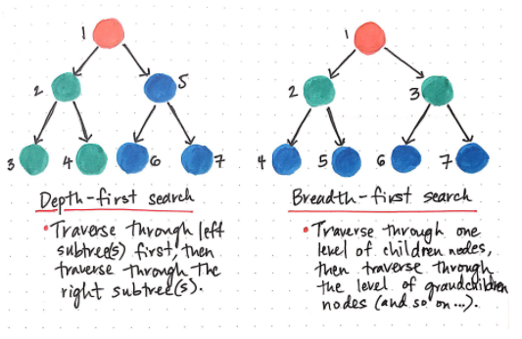
Difference between BFS and DFS

Slide 9
BFS using Queues
A Queue is a linear structure which follows a particular order in which the operations are performed.
The order is First In First Out (FIFO). A good example of a queue is any queue of consumers for a resource where the consumer that came first is served first

Slide 10
Queue
[ _ _ ]
[ _ 1 ]
[ 1 4]
[4 5]

Slide 11
Binary numbers
‘0’ and ‘1’
Q = (“ ”)
For in range(15)
X = Q.get()
Y =X+0
Z= X+1
{ }
{0 , 1}
X=0
Y=00
Z=01

Slide 12
Binary numbers
‘0’ and ‘1’
Q = (“ ”)
For in range(15)
X = Q.get()
Y =X+0
Z= X+1
{ 0,1 }
{1,00,01}
X=1
Y=10
Z=11
{00,01,10,11}

Slide 13
U D L R
“up” “down” “left” “right”
Q = (“ ”)
LOOP:
X = Q.get()
Add1= x + “U”
Add2= x + “D”
Add3= x + “L”
Add4= x + “R”

Slide 14
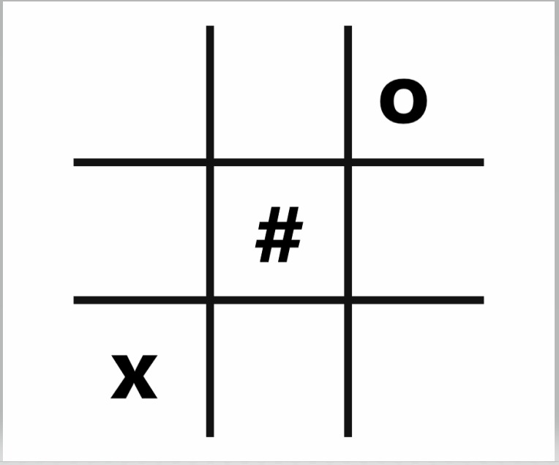
[ L , D ]

Slide 15
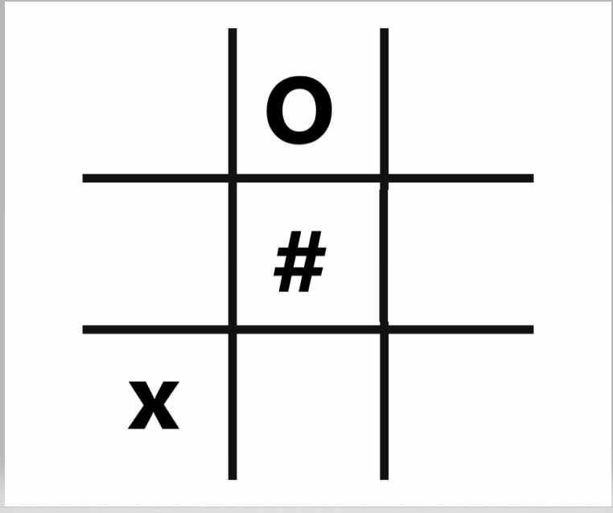
[ L , D ]
[ D,LL,LR ]

Slide 16
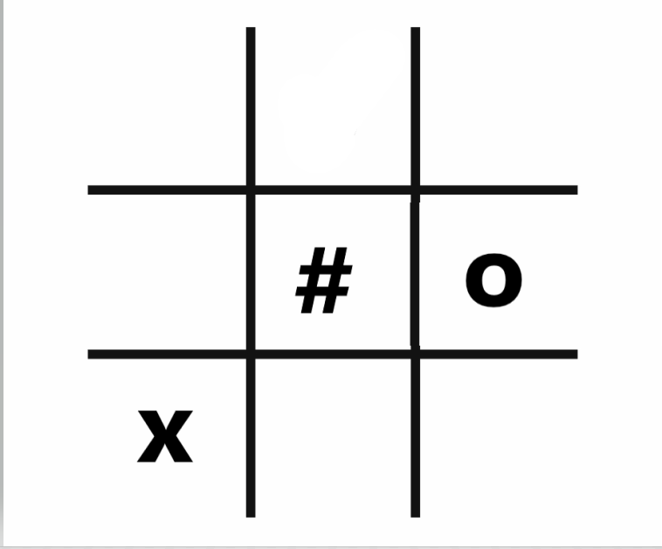
[ DD,DU ]
[ LL,LR,DD,DU ]

Slide 17
[ LLDD]
[ DDLL ]

Slide 18
THANK YOU

